Slide 1

INTERNSHIP JOURNY

Slide 2

Contents:-
Internship type.
Company details.
How did I find internship?.
Responsibility.
Learning Process and Topics.
Project Details and User Interface.
Personal benefits.
Conclusion.

Slide 3

Internship type:-
Software Developer

Slide 4
Internship At TNBCC
Employer Details:-
Contact person chandu
Email id work4tnbcc@gmail.com
Contact no. 8179270055

Slide 5
TNBCC Company
About:
“Online based start-ups where many innovative ideas are turned in to real-time prototypes. We believe in practical skills rather than classroom study. We encourage the students to work with our team resulting in developing their skills and gain some experience. We provide guidance to students and get them equipped with an industrial environment.”
www.tnbcc.tech

Slide 6
How Did I find it?
Through let’s interns app.
Also available on Internshala .
www.tnbcc.tech

Slide 7
Responsibilities:-
Candidate should Work 2-3 hours/day .
She/he should able to work in a given team and should be dedicated towards the given works.
Candidate should be feasible to send their work through GitHub.
Candidate should complete his/her work within given time period.

Slide 8
Learning Process and Topics:
some task is given with some period of time and after completed and practices upload them on GitHub Account.
12 to 15 days internship training period .
During internship training period there are some topic which has been covered(basics):-
      HTML
      CSS

Slide 9
Learning Process and Topics(cont..)
  BOTSTRAP
  JAVASCRIPTS
  AJAX
  MONGODB
  PYTHON FLASK

Slide 10
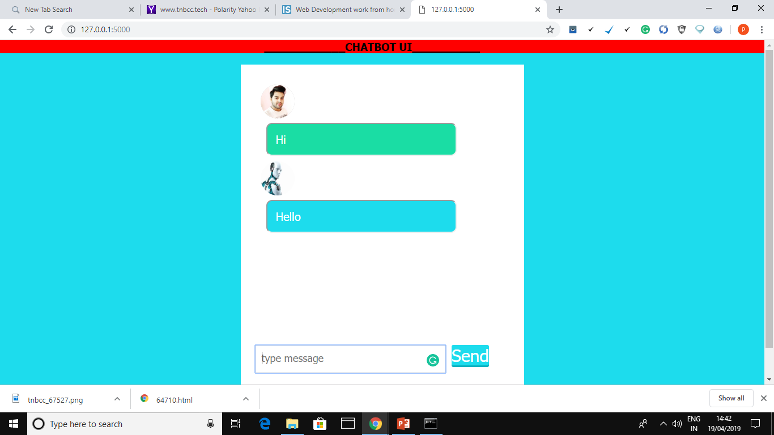
Project Details:
Problem statement:-
“ Design a simple web based chatbot application using mongo dB database. Take a 100 instances of daily life conversations as a dataset for chatbot.”
Chatbot User Interface:-

Slide 11
User Interface:-

Slide 12
Internship Benefits:-
Internship has long-term benefits.
Employers use internships as a trial period.
They will pick/prefer interns.
It is important to make a good impress.
Be enthusiastic, show your flexibility and commitment.

Slide 13
Personal benefits:-
Hands-on work Experience.
Acquainted with fields of interest.
Working experience in a virtual environment as a team.
Learned new skills with hands on .
Working experience on real life live project.
Network with professionals in the field of interest.
Gain confidence.

Slide 14
Conclusion:-
My experience at TNBCC is not only about the internship but also it taught me that how to handle the real life problem .and working with the team .it also help me the proper way of solving of real life problem in effective way. During the internship period my supervisor is very attentive and always help me to solve the problem if any came .

Slide 15
Thank you

